Slide 1
CFO 4.0
Group 3
Gunay Farajova
Kübra Karagöz
Md Sirajul Islam
Tim Eckhardt
04.12.2020
Philipps University of Marburg

Slide 2
Outline
Introduction
Sales analysis
Customer analysis
Ratings & Tax
Recommendations & Conclusion

Slide 3

Introduction
Large company
Dealer of various wines
DeVine Bliss

Slide 4
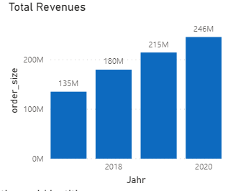
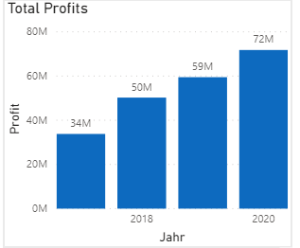
Total Revenues & Profits
Increasing trend with slight change in last years
Doubled profit over the period

Slide 5
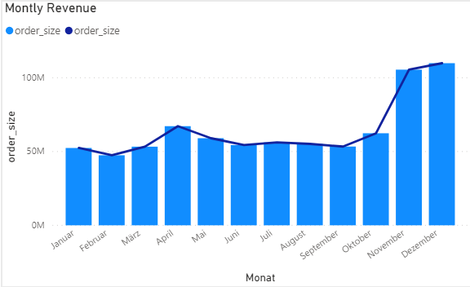
Sales Revenue
High increase in November & December (Christmas period)
Notes:
Sales revenue shows high increase in November and December considering Christmas period it seems normal

Slide 6
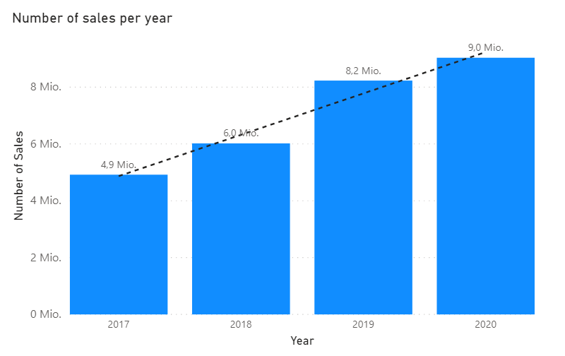
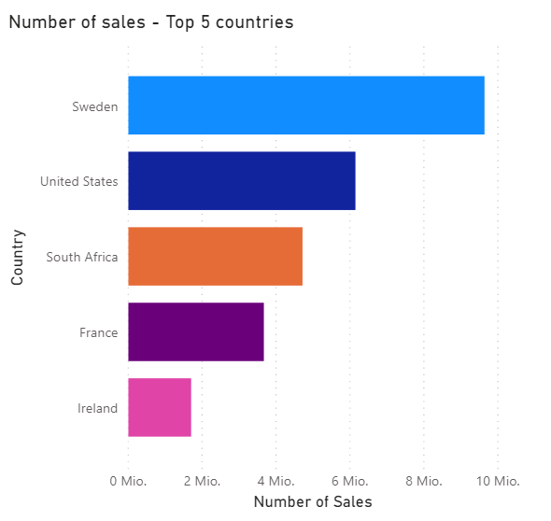
Sales Quantity

Slide 7
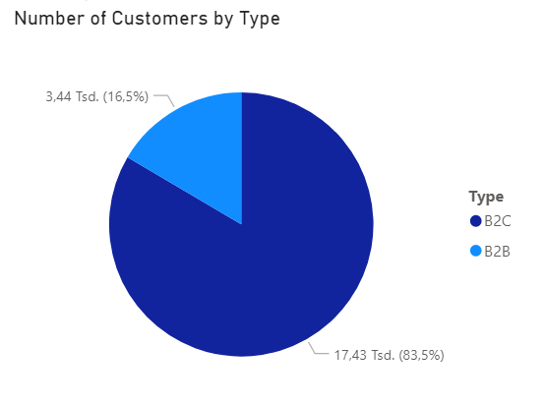
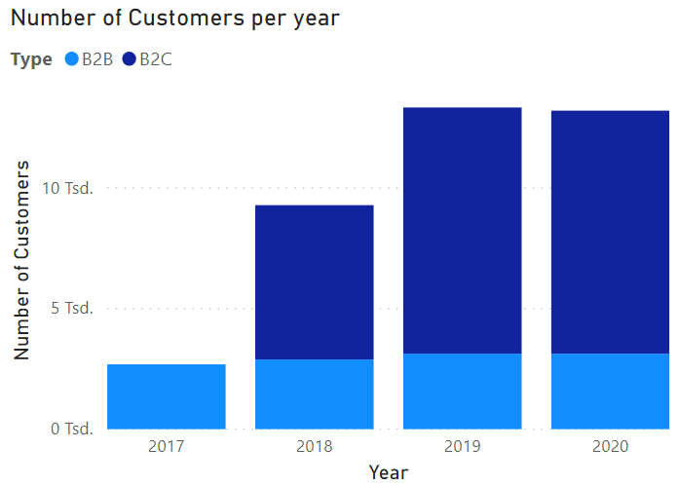
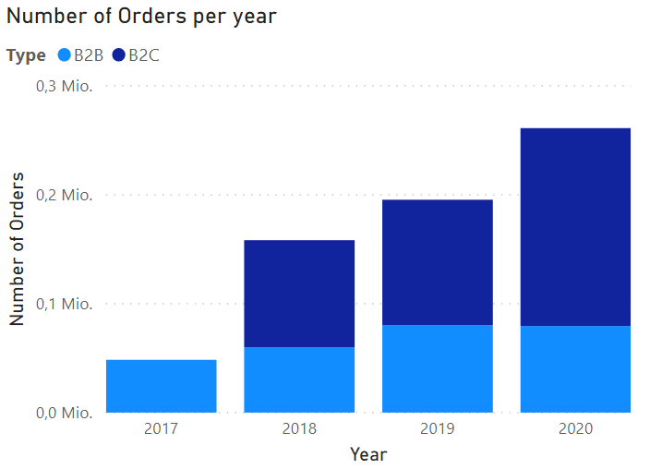
Customer Analysis

Slide 8
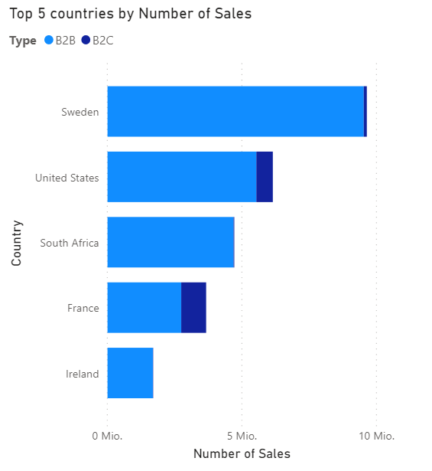
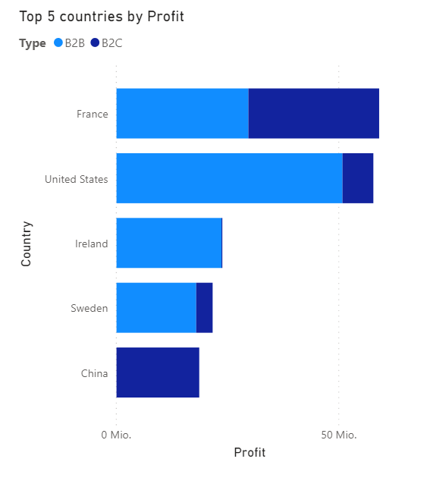
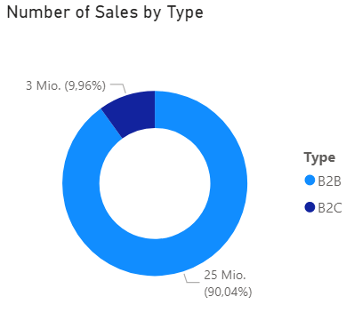
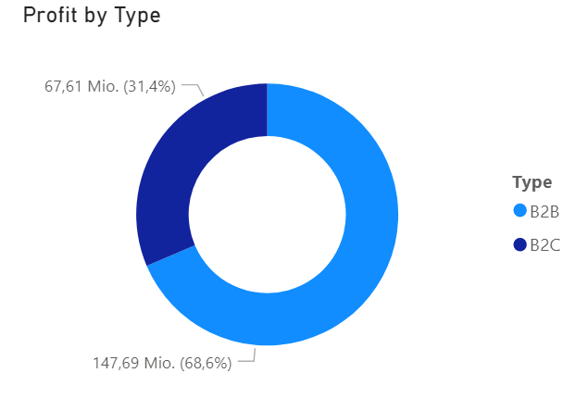
Customer Analysis
🡪 More Countries with B2C transactions

Slide 9
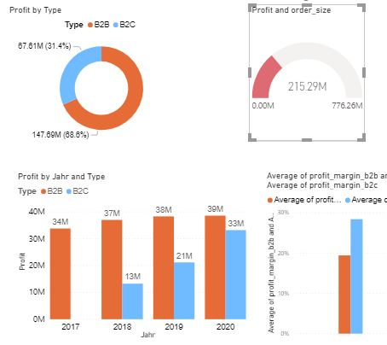
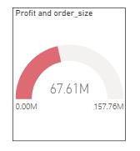
Profit and Order size in B2B and B2C Market

Slide 10




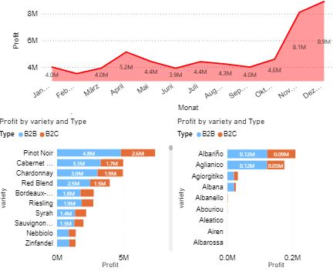
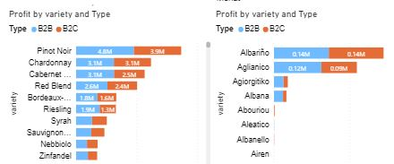
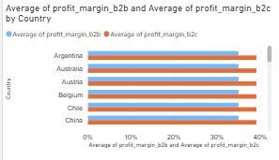
Profit, Bottle sold, Top and Bottom Products in B2B and B2C

Slide 11
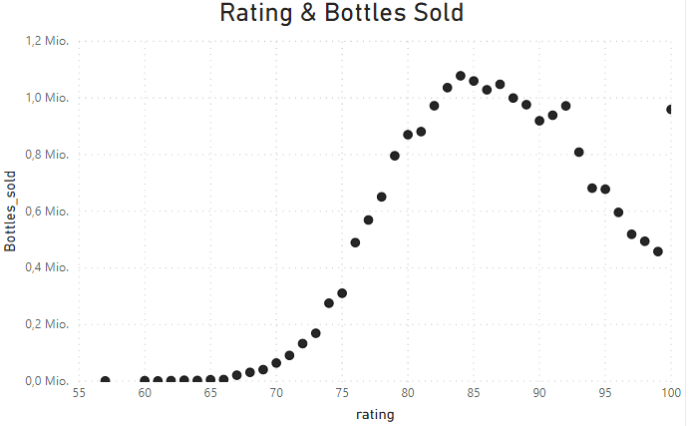
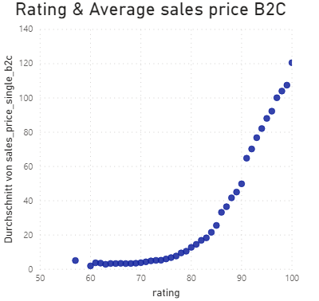
Rating Analysis
→ use rating as an indicator for quality of products as experienced by customers

Slide 12
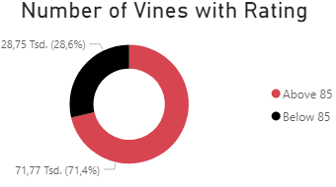
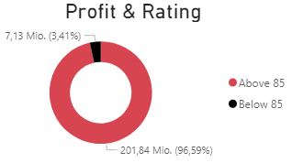
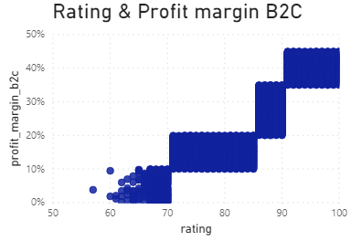
Rating Analysis
→ use rating as an indicator to eliminate products from our portfolio

Slide 13
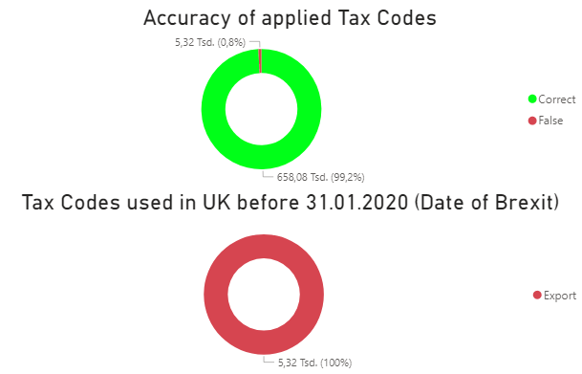
Tax Analysis: Accuracy of applied taxes

Slide 14
Recommendations
focus on B2C most potential with increasing number and higher profit margins
do not neglect B2B which still generates most sales → introduce to countries with no B2B to increase customers, e.g. China
increase minimum order size
eliminate products with low profit (margin)
eliminate or improve products with low rating
→ cutting costs by eliminating
make prices dynamic to react to market changes

